Slide 1
September 9, 2013

Slide 2
ETHNN Mission
“To strengthen services to meet diverse human needs through the collaboration of individuals and organizations.”

Slide 3
COLLABORATION is…
… a purposeful,
strategic way of working
that leverages the resources of each party
for the benefit of all
by coordinating activities and communicating information
within an environment
of trust and transparency.

Slide 4
Agenda
Welcome
Introductions
Community Organizing
Comprehensive Community Assessment
Data teams
Secondary Source Data
Committee work
Closing

Slide 5
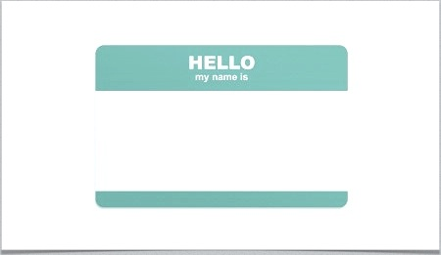
Introductions

Slide 6
HUNGER: What role do you play?
Introduction to all the programs of the Texas Hunger Initiative
Tuesday, October 1 at 1:00 pm
3201 West NW Loop 323 Tyler, TX 75702
Register online at www.ethnn.org – link on home page

Slide 7
ETHNN Conference on Human Needs
Monday, November 18
1:00 – 5:00
Tyler Junior College West Campus
SAVE THE DATE!
Registration will open soon

Slide 8
ETHNN One Night Without A Home
Tuesday, November 19 4:00 pm
Wednesday, November 20 6:00 am
Start at Salvation Army, will walk to Bergfeld Park for Homelessness program and overnight stay. Early rise with breakfast from Salvation Army Canteen. Lessons learned discussion. Walk back to Salvation Army. Work, School, or Home.
SAVE THE DATE!
Registration will open soon.

Slide 9
Community Assessment Data Teams
Fred Peters Rhonda McGrath Carlton Allen Christina Fulsom
Marty Barbieri Karen Wilkerson Kim Bush Julie Goodgame
Gloria Bell Kristy Range Jim Snow Dana Bias
Jamal Moharer Gretchen Martens One pending

Slide 10
Secondary Source Data Received
Cornerstone Assistance Center
Veterans Roundtable
Andrews Center
PATH
The Salvation Army
East Texas Food Bank
Samaritan Counseling Center
Tyler Junior College
IF YOUR AGENCY HASN’T SUBMITTED YET,
PLEASE COME SEE ME AFTER THE MEETING TO SEE IF I CAN HELP

Slide 11
COMMITTEE WORK
Education and Employment will meet in classroom down the hall.
Housing and Healthcare will meet here.
Subcommittees may meet to discuss data:
Transportation
Veterans

Slide 12
FEEDBACK FORM
Please write down your comments and suggestions
If you want me to contact you, please complete the following:
Date:
Name:
Phone #:
Email address:

Slide 13
THANK YOU!
Next meeting
Monday, October 14
2:00 – 3:30 pm
The Salvation Army Multipurpose Room
THANK YOU ANDREA!!!!!

