Slide 1
October 14, 2013

Slide 2
ETHNN Mission
“To strengthen services to meet diverse human needs through the collaboration of individuals and organizations.”

Slide 3
COLLABORATION is…
… a purposeful,
strategic way of working
that leverages the resources of each party
for the benefit of all
by coordinating activities and communicating information
within an environment
of trust and transparency.

Slide 4
Agenda
Welcome
Introductions
The Salvation Army – Workers Dorm Program
One Night Without A Home
Human Needs Conference
Poverty Conference
Committee updates and break-out work
Closing

Slide 5
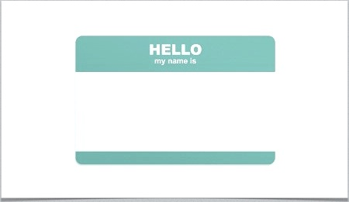
Introductions

Slide 6
Workers Dorm Program
Andrea Wilson

Slide 7
Center for Healthy Living
http://www.ethnn.org/center-for-healthy-living.html
Grand Opening and Ribbon Cutting Wednesday, October 16th 1:00 pm 2815 Frankston Hwy., Tyler, TX

Slide 8
ONE NIGHT WITHOUT A HOME
Tuesday, November 19 4:00 pm
Wednesday, November 20 6:00 am
Start at Salvation Army, will walk to Bergfeld Park for Homelessness program and overnight stay. Early rise with breakfast from Salvation Army Canteen. Lessons learned discussion. Walk back to Salvation Army. Work, School, or Home.
REGISTER TODAY! www.ETHNN.org
FORWARD INVITATION TO FRIENDS, FAMILY, AND COLLEAGUES

Slide 9
HUMAN NEEDS CONFERENCE
Monday, December 2
1:00 – 5:00
Tyler Junior College West Campus
REGISTER TODAY! www.ETHNN.org
FORWARD INVITATION TO COLLEAGUES OR SHARE DISTRIBUTION LIST & WE WILL SEND IT

Slide 10
Secondary Source Data Received
Cornerstone Assistance Center
Veterans Roundtable
Andrews Center
PATH
The Salvation Army
East Texas Food Bank
Samaritan Counseling Center
Tyler Junior College
Smith County Bar Association
IF YOUR AGENCY HASN’T SUBMITTED YET,
FINAL DEADLINE – THIS FRIDAY OCTOBER 18

Slide 11
POVERTY CONFERENCE
Poverty Conference
April 14, 2014
1:00 – 5:00
Tyler Junior College West Campus
SAVE THE DATE!
www.ETHNN.org

Slide 12
COMMITTEE UPDATES & WORK GROUPS
Education and Employment – Life Skills/Employment/Mentoring
Housing – Tenant Education
Healthcare – Healthcare Act & Market Navigators

Slide 13
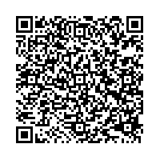
More ways to Join Our Mailing List
It's easy to join our mailing list!
Just send your email address
by text message:
Text
HUMANNEEDS
to 22828 to get started.
Scan QR Code to join our mailing list!

Slide 14
Do you “Like” us on facebook?
https://www.facebook.com/HumanNeedsNetwork

Slide 15
FEEDBACK FORM
Please write down your comments and suggestions
If you want me to contact you, please complete the following:
Date:
Name:
Phone #:
Email address:

Slide 16
THANK YOU!
Next meeting
Monday, November 11
2:00 – 3:30 pm
The Salvation Army Multipurpose Room
THANK YOU ANDREA!!!!!

