Slide 1
November 11, 2013

Slide 2
ETHNN Mission
“To strengthen services to meet diverse human needs through the collaboration of individuals and organizations.”

Slide 3
COLLABORATION is…
… a purposeful,
strategic way of working
that leverages the resources of each party
for the benefit of all
by coordinating activities and communicating information
within an environment
of trust and transparency.

Slide 4
Agenda
Welcome
Introductions
One Night Without A Home
Human Needs Conference
Committee updates and break-out work
Closing

Slide 5
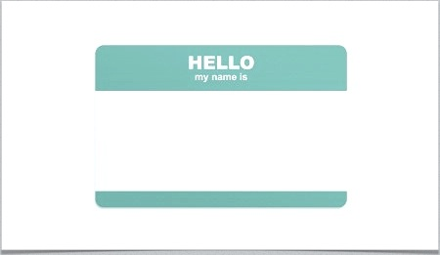
Introductions

Slide 6
ONE NIGHT WITHOUT A HOME
Tuesday, November 19 4:00 pm
Wednesday, November 20 7:00 am
Start at Salvation Army, will walk to Bergfeld Park for Homelessness program and overnight stay. Early rise with breakfast from Salvation Army Canteen. Lessons learned discussion. Walk back to Salvation Army. Work, School, or Home.
REGISTER TODAY! www.ETHNN.org
FORWARD INVITATION TO FRIENDS, FAMILY, AND COLLEAGUES

Slide 7
HUMAN NEEDS CONFERENCE
Monday, December 2
1:00 – 5:00
Tyler Junior College West Campus
REGISTER TODAY! www.ETHNN.org
FORWARD INVITATION TO COLLEAGUES OR SHARE DISTRIBUTION LIST & WE WILL SEND IT

Slide 8
POVERTY CONFERENCE
Poverty Conference
April 14, 2014
1:00 – 5:00
Tyler Junior College West Campus
SAVE THE DATE!
www.ETHNN.org

Slide 9
COMMITTEE WORK GROUPS
EDUCATION & EMPLOYMENT
HEALTH CARE
BEHAVIORAL HEALTH
HOUSING

Slide 10
FEEDBACK FORM
Please write down your comments and suggestions
If you want me to contact you, please complete the following:
Date:
Name:
Phone #:
Email address:

Slide 11
THANK YOU!
Next meeting
Monday, December 9
2:00 – 3:30 pm
The Salvation Army Multipurpose Room

