Slide 1
August 12, 2013

Slide 2
ETHNN Mission
“To strengthen services to meet diverse human needs through the collaboration of individuals and organizations.”

Slide 3
COLLABORATION is…
… a purposeful,
strategic way of working
that leverages the resources of each party
for the benefit of all
by coordinating activities and communicating information
within an environment
of trust and transparency.

Slide 4
Agenda
Welcome
Introductions
Carlton Allen, Chair Healthcare Committee
Updates
Comprehensive Community Needs Assessment
Closing

Slide 5
Healthcare Committee
Carlton Allen, Chair
Administrative Community Liaison for the patient navigator program, part of UT Health Northeast’s Delivery System Reform Incentive Payment (DSRIP) projects.
Mr. Allen holds a Bachelors of Science in Health Professions and a Master of Science in Health Sciences with a concentration in Social Network Analysis.
Mr. Allen comes with experience in community health promotion, assessment, and networking. He has interest in underserved and diabetic populations, and hopes to continue serving them. He held an internship position working under the executive director at the H.O.P.E center in Jacksonville, Texas. He also held a graduate assistant position at the University of Texas at Tyler in the academic advising office.

Slide 6
Updates
Bright Ideas for Success Conference – Nov. 15th – Nonprofit Development Center www.BrightIdeasForSuccess.com
211 – Community Resource Guide - $24.65 211info@uwtyler.org
Standards for Charity Accountability - Better Business Bureau - Jim Judge 888-253-3385
CareScope - Smith County Medical Society
Gateway to Hope - Education program
Community Partner Program with DSHS - Ryan Surratt - Texas Hunger Initiative
US Census Bureau – Susana Privett – Data Dissemination Specialist

Slide 7
Comprehensive Community Needs Assessment
The purpose of this assessment is to discover the unique needs of this community as it relates to education, employment, health care, housing, child care, transportation, and legal matters.

Slide 8
PROGRESS
Define scope
Design survey instrument
Enlist and train participating agencies and volunteers
Implement survey data collection - Primary source data
Collect secondary source data – Survey will be emailed today
Determine key findings
Set priorities
Create an Action Plan
Share findings – December 9th (tentative) Half day conference

Slide 9
Community Partners
38 Interviewers
14
Agencies

Slide 10
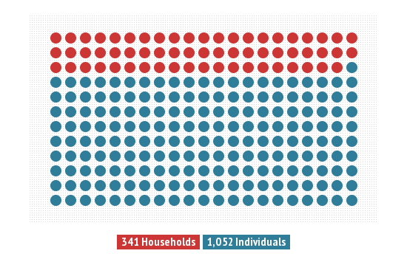
Respondents

Slide 11
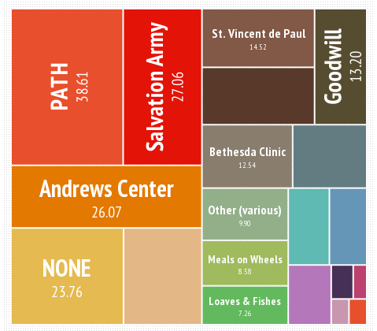
Agencies Providing Assistance

Slide 12
DEMOGRAPHICS

Slide 13
Family Makeup

Slide 14
Percentage of Families Living Below Poverty by Family Size

Slide 15
FINANCIAL

Slide 16
RESOURCES

Slide 17
FINANCIAL

Slide 18
FINANCIAL

Slide 19
EXPENSES

Slide 21
Educational Needs

Slide 22
Educational Needs
6.73% of households had children who transferred schools an average of 1.5 times during the last 24 months because the family moved

Slide 23
EMPLOYMENT

Slide 24
Reasons for Unemployment

Slide 25
Employment Needs

Slide 26
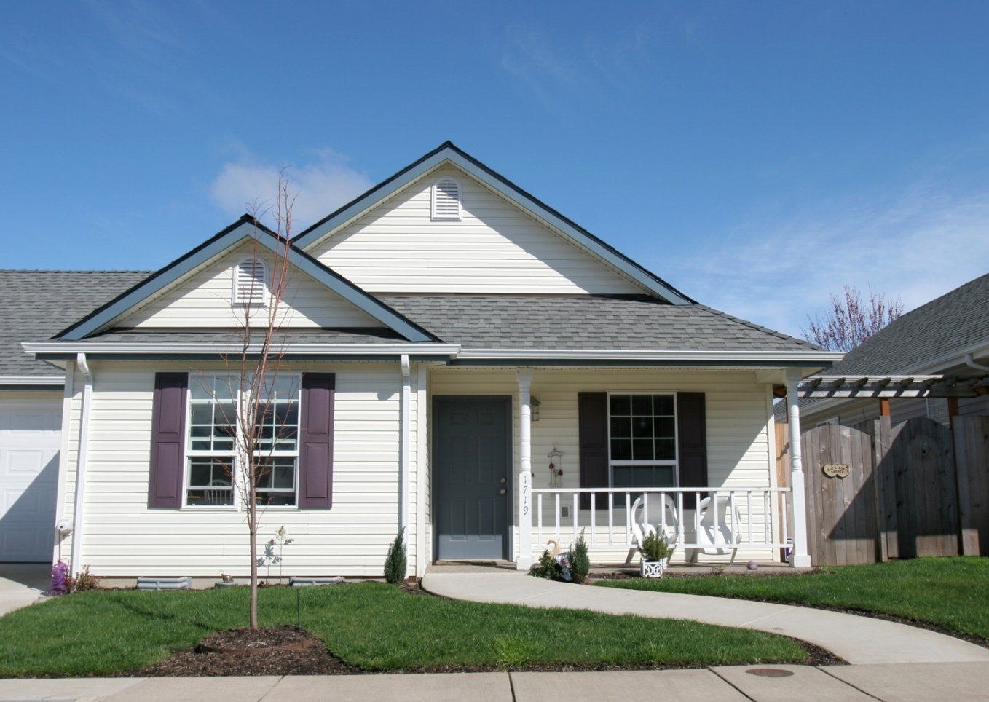
HOUSING

Slide 27
Housing Needs

Slide 28
HEALTHCARE

Slide 29
Healthcare Needs

Slide 30
CHILDCARE
33.23 % of respondents have children under the age of 18
70% report that they are the primary caretaker of their minor children

Slide 31
CHILDCARE

Slide 32
ADULT DEPENDENT CARE

Slide 33
SELF REPORTED HEALTHCARE NEEDS

Slide 34
TRANSPORTATION

Slide 35
VETERANS

Slide 36
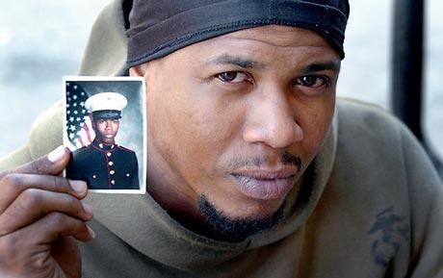
Veterans Needs

Slide 37
LEGAL

Slide 38
What is next?
Collect secondary source data
Survey will be emailed today
Determine key findings
Set priorities
Create an Action Plan
Share findings
December 9th (tentative) Half day conference

Slide 39
Questions you didn’t get to ask?
Use FEEDBACK FORM
Call or Email Christina
903.216.3211
christina@ethnn.org

Slide 40
THANK YOU!
Next meeting
Monday, September 9th
2:00 - 3:30 pm
The Salvation Army Multipurpose Room

